Slide 1



State Management

Slide 2
1.
Intro to State Management

Slide 3
What is a state?
The state of an app is everything that exists in memory while the app is running.

Slide 4
Types of states

Slide 5
Ephemeral State
Ephemeral state is a state you can nearly contain in a single widget.
There is mostly no need to use state management techniques, Stateful widget would be enough.

Slide 6
App State
App state is state that you need to share across many parts of your app and that you need to keep across user sessions.

Slide 7
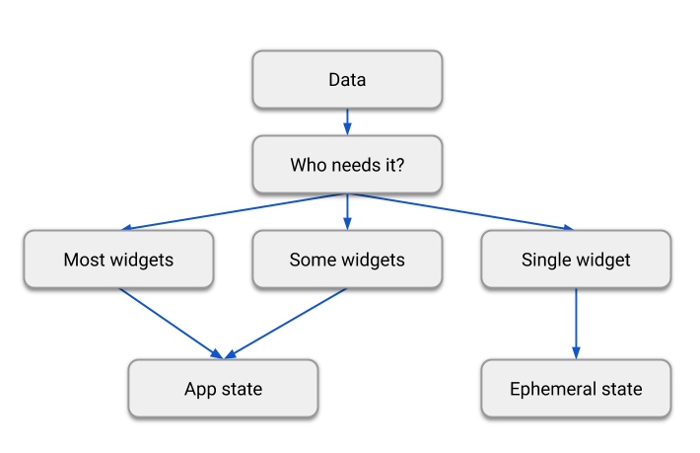

Slide 8
What is a state management?
State management refers to how data or state is handled within the flutter app.
Proper state management ensures the UI updates are efficient, preventing unnecessary widget rebuilds and performance issues.

Slide 9
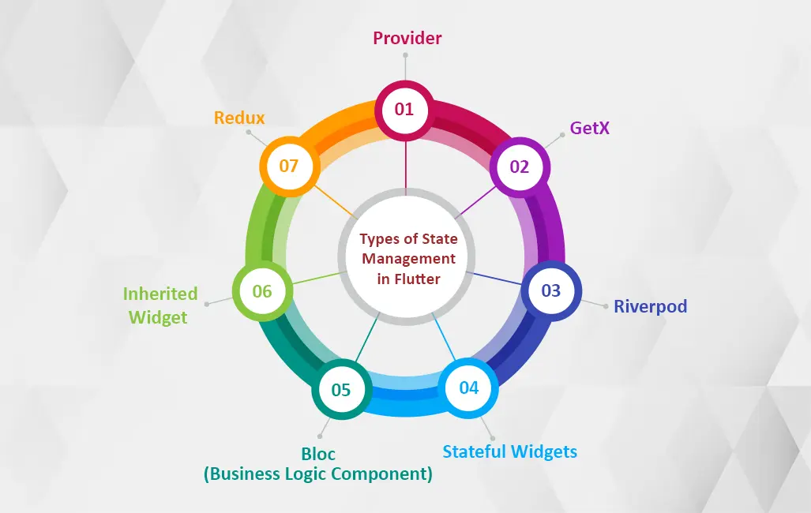
Popular state management approaches

Slide 10
2.
BLoC

Slide 11
BLoC
BLoC (Business Logic Component) focuses on separating business logic from UI.

Slide 12
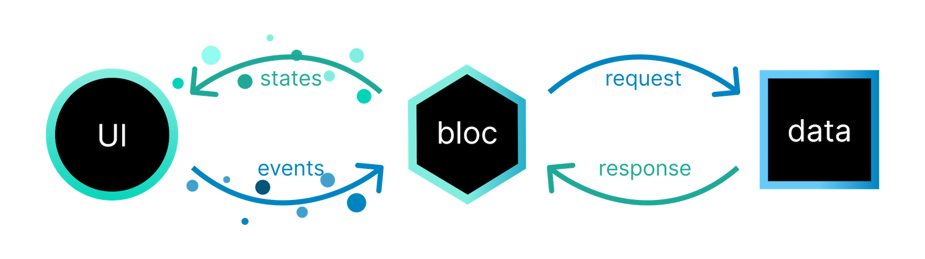
BLoC

Slide 13
3.
Cubit

Slide 14
Cubit state management
Cubit is a state management provided by BLoC, it’s like a lightweight BLoC.
It removes the concept of events and relies on direct method calls to change state.

Slide 15
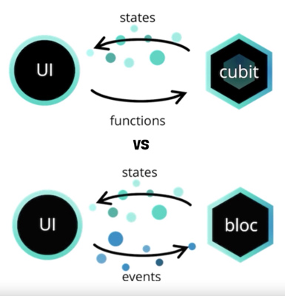

Slide 16
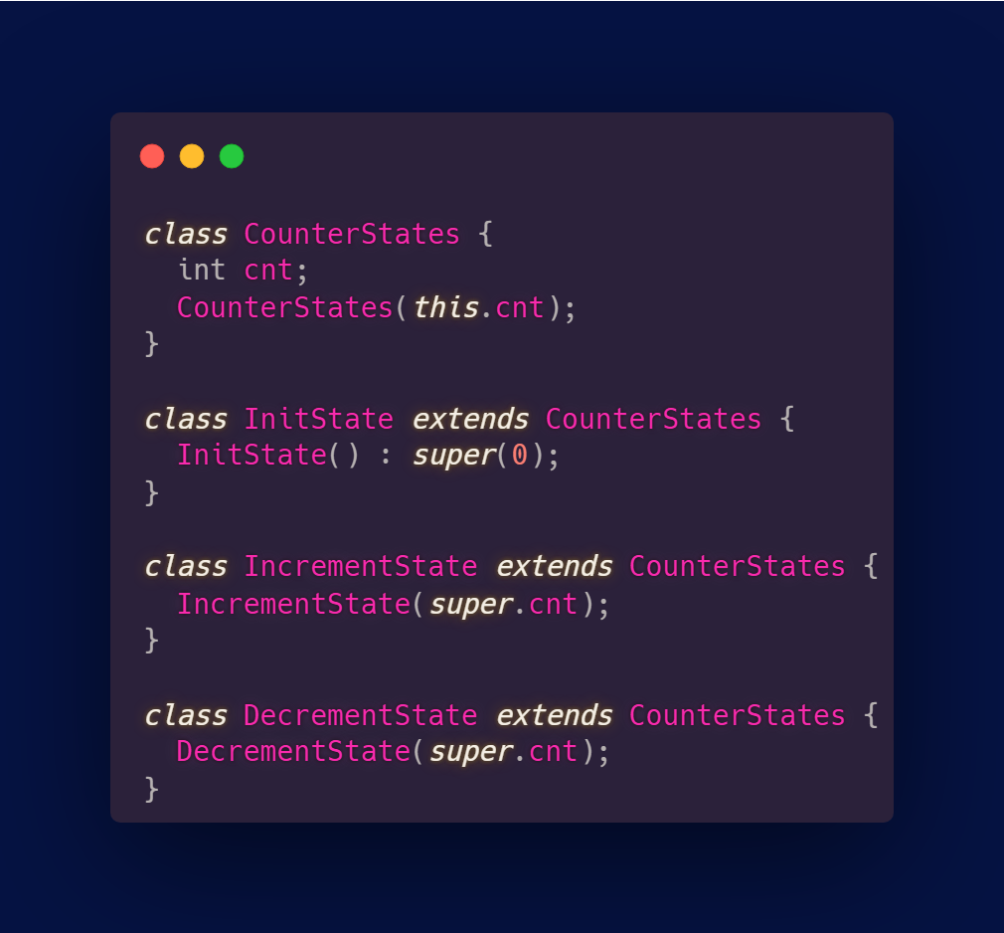
States

Slide 17
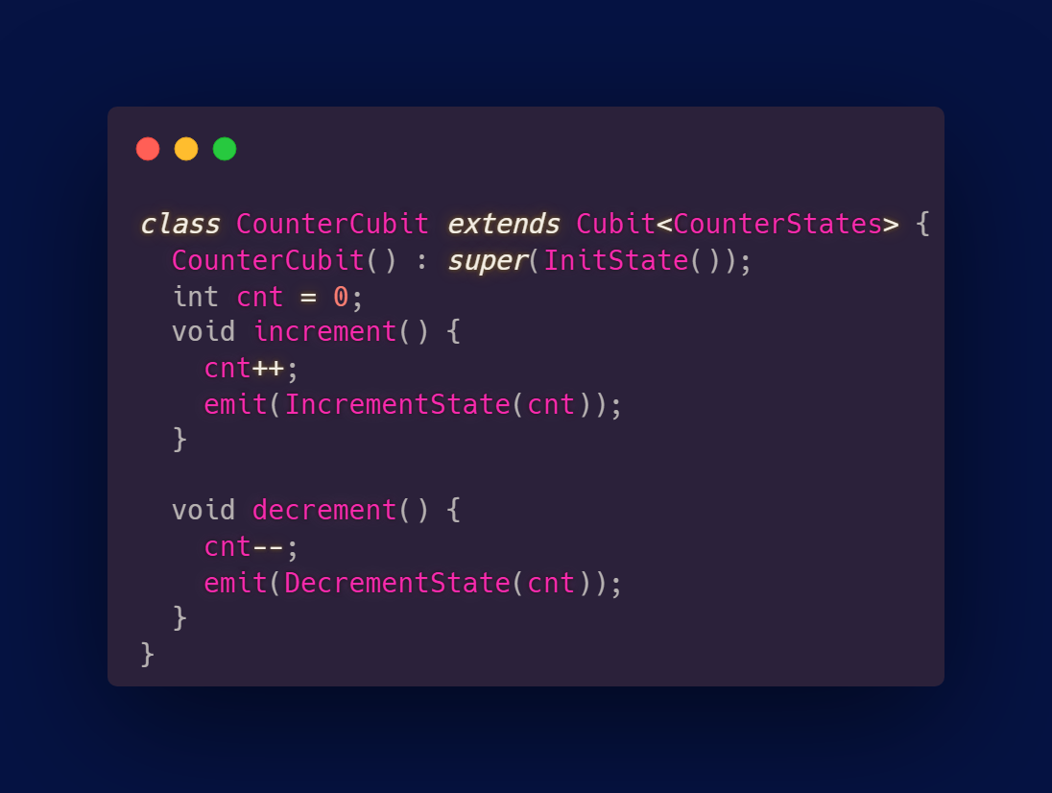
Cubit

Slide 18
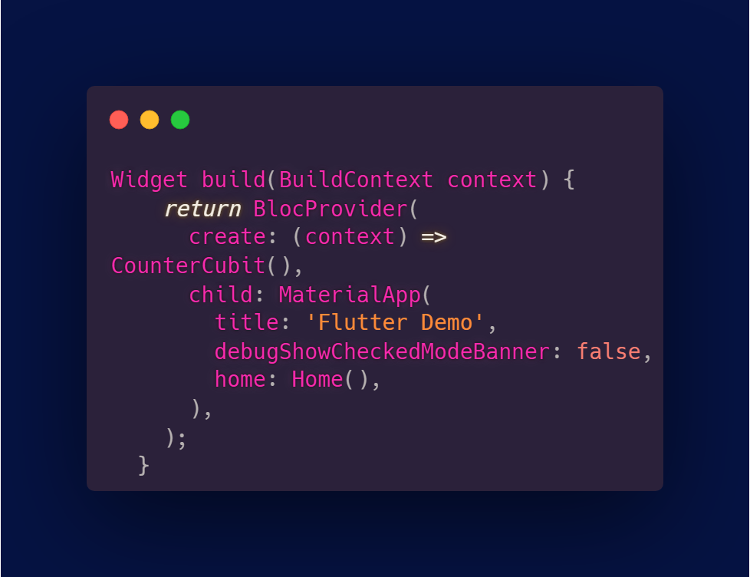
BlocProvider

Slide 19
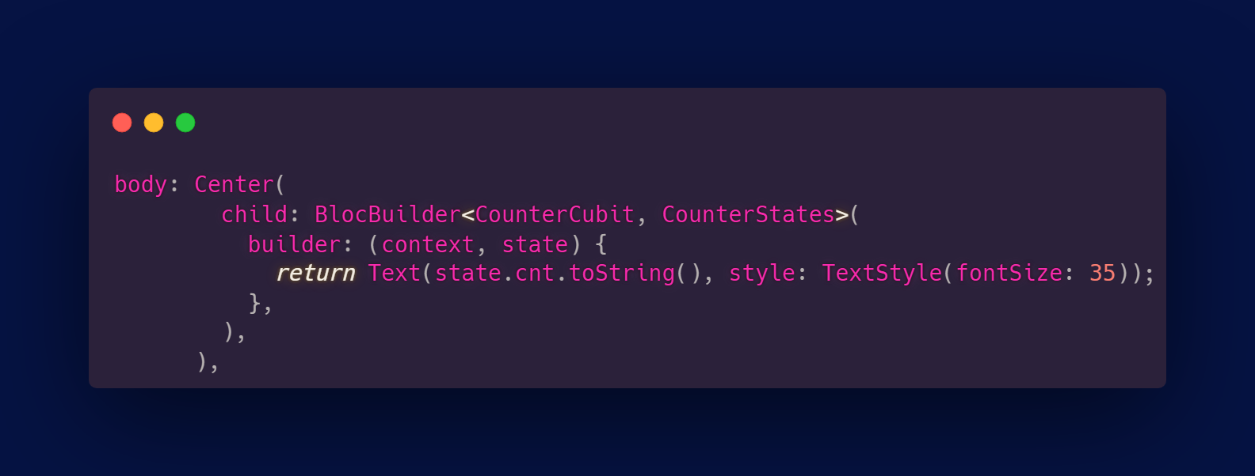
BlocBuilder

Slide 20
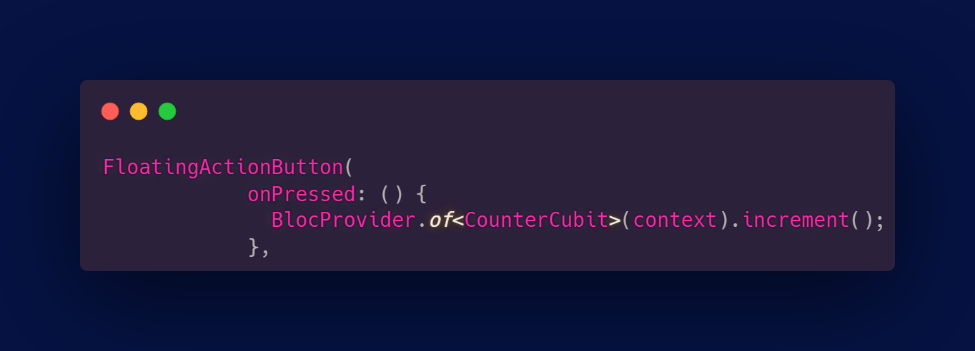
Calling function from cubit

Slide 21
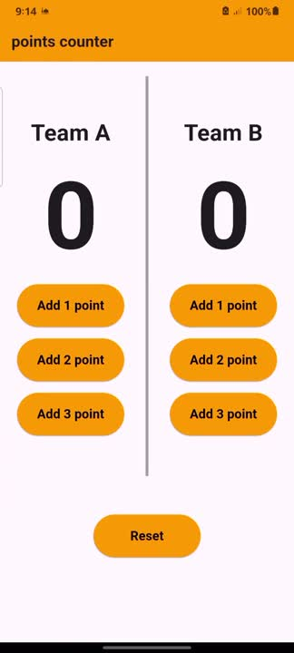
Hands on
Use cubit state management,
(Hint: States should be: -> Add points for team A
-> Add points for teams B
-> The reset for both)

Slide 22
Thank you!

